Slide 1
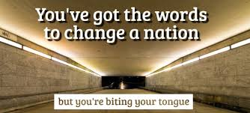

Slide 2
A Nation Church
What will it take for you to be a part of a Nation Church?

Slide 3
A Nation Church
King James Bible 1 Peter 2:9
But ye are a chosen generation, a royal priesthood, an holy nation, a peculiar people; that ye should shew forth the praises of him who hath called you out of darkness into his marvelous light:

Slide 4
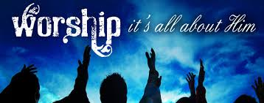

Slide 5
A Nation Church
A Nation Church is a Worshiping Church
The Purpose of Worship
To bring the Nation into the presence of the Lord.
“ …. come before his presence with singing.” Ps. 1,2.
To make a throne for the Lord to rule
Psalm 22:3 (NKJV)
3 “But You are holy, Enthroned in the praises of Israel”
God dells in our praise.
God remains in our praise.

Slide 6
A Nation Church is a Worshiping church
C. We worship to give glory to God
a. Psalm 50:23 (NKJV)
23 “Whoever offers praise glorifies Me;”
D. For Us To Enjoy Him
a. Psalm 16:11 (KJV)
11 “Thou wilt shew me the path of life: in thy presence is fullness of joy; at thy right hand there are pleasures for evermore.”

Slide 7
A Nation Church
To release the miracle working power in a Nation
a. Acts 16:25 (KJV)
25 “And at midnight Paul and Silas prayed, and sang praises unto God: and the prisoners heard them.
26 And suddenly there was a great earthquake, so that the foundations of the prison were shaken: and immediately all the doors were opened, and every one's bands were loosed.

